Slide 1

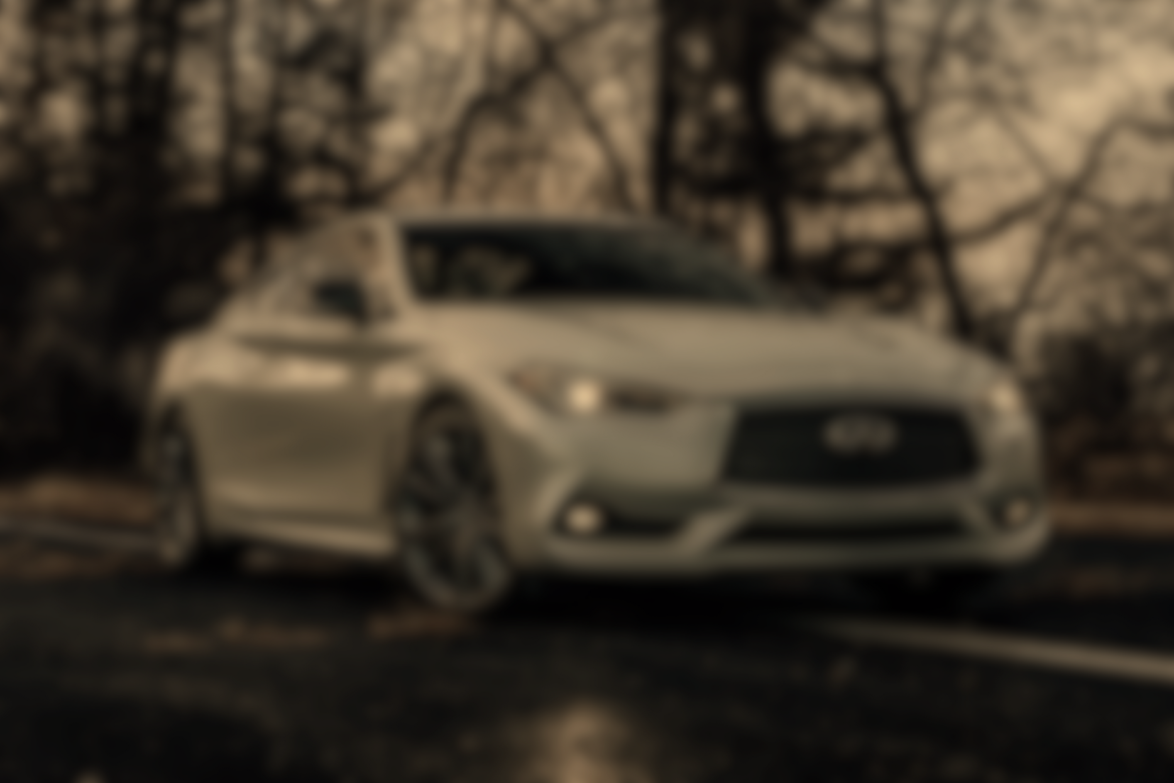
DEEP LEARNING FOR DECIPHERING TRAFFIC SIGNS
By Team7 : Yifan Fan, Victor Floriano, and Jose Salerno

Slide 2
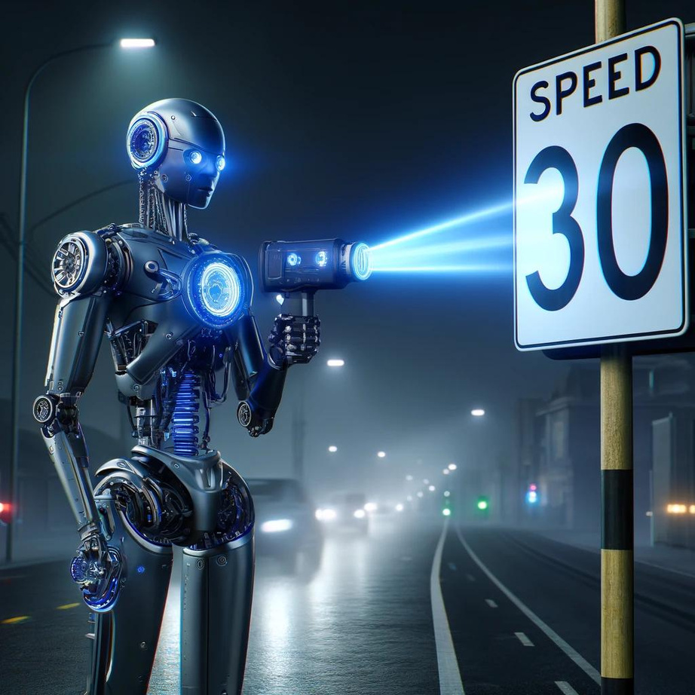
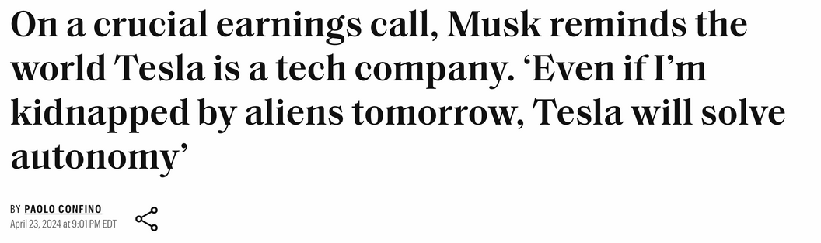
BUSINESS PROBLEM: CLASSIFYING TRAFFIC SIGNS
Over 250 automakers are currently developing fully autonomous vehicles
Our goal is to aid major manufacturers by developing models that effectively classify traffic signs
Identification of traffic signs enhances autonomous and assisted driving software, improving general driving safety

Slide 3


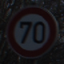

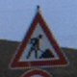



GTSRB
DATA
Dataset: German Traffic Sign Recognition Benchmark (GTSRB)
Images: 51,839
Train: 39,209
Test: 12,630
Classes: 43
Large, lifelike database
Reliable ground-truth data

Slide 4
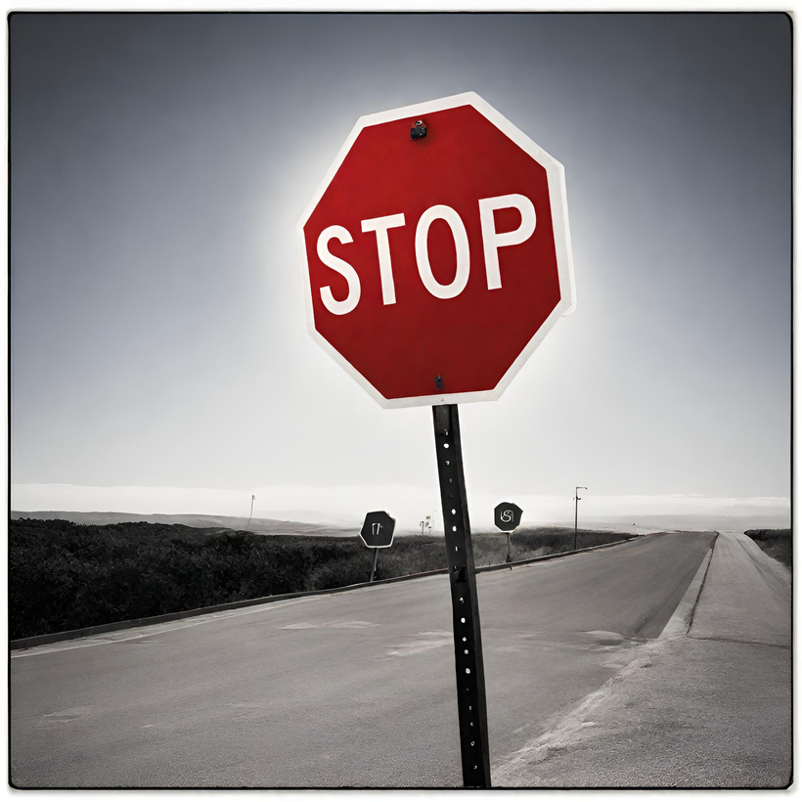
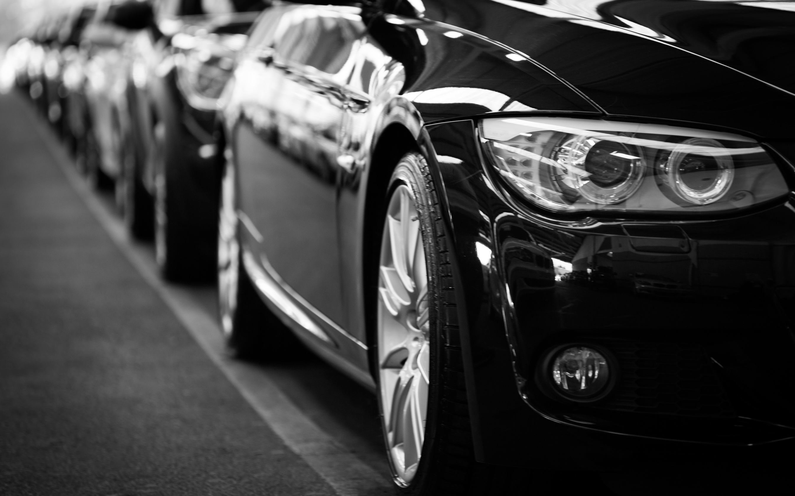


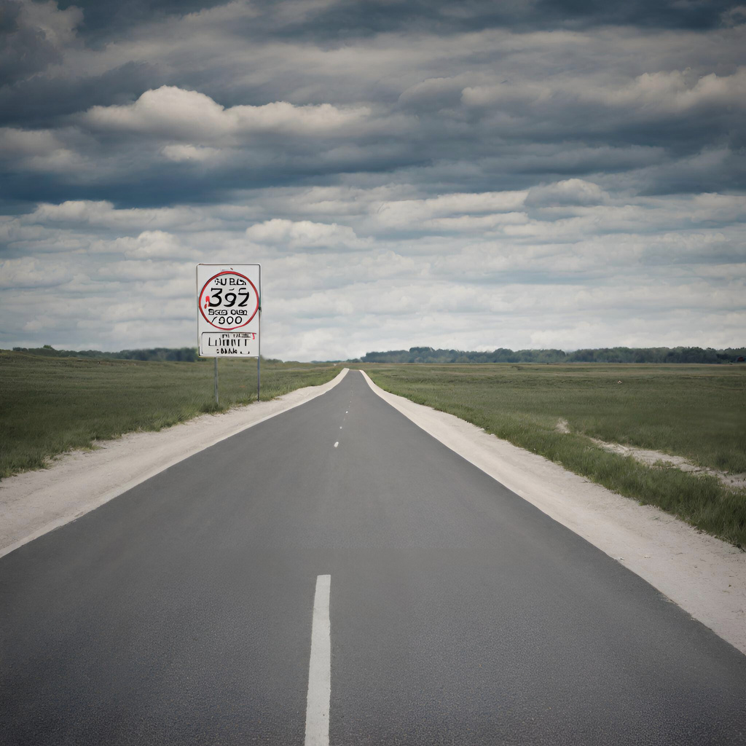
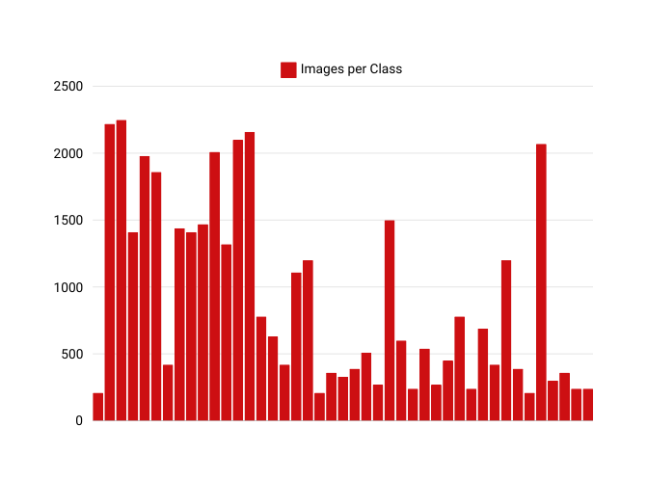
EXPLORATORY DATA ANALYSIS
Inconsistency in data organization
Create classes for the testing Dataset
Variation in Image Resolutions
Calculate the average resolution 56x56 as a baseline
Imbalanced Classes
Calculate the Weights per Class
BCEWithLogitsLoss function
BCEWithLogitsLoss function
Combines Sigmoid layer and BCELoss in one single class (log-sum-exp trick)

Slide 5

SVM - baseline
Baseline model
Converted Images to grayscale, 32x32 resolution
Utilized Radial Basis Function (RBF)
Handling non-linearity relationships
Validation Accuracy : 86%

Slide 6
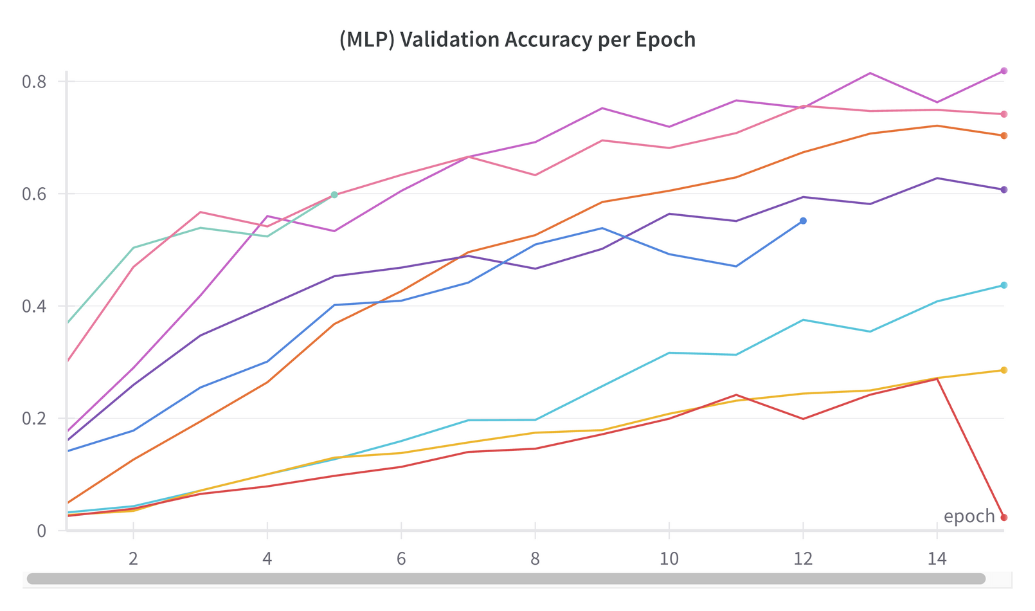
MLP
Random Search to tune the hyperparameters
Images normalized and re-sized to 16x16
Dynamic number/size of hidden layers
Configurations: 9 | Epochs: 15
Hyperparameter tested:
Learning Rate
Batch Size
Data Augmentation
Batch Normalization
Dropout Rate
Weight Decay
Validation Accuracy : 82%

Slide 7
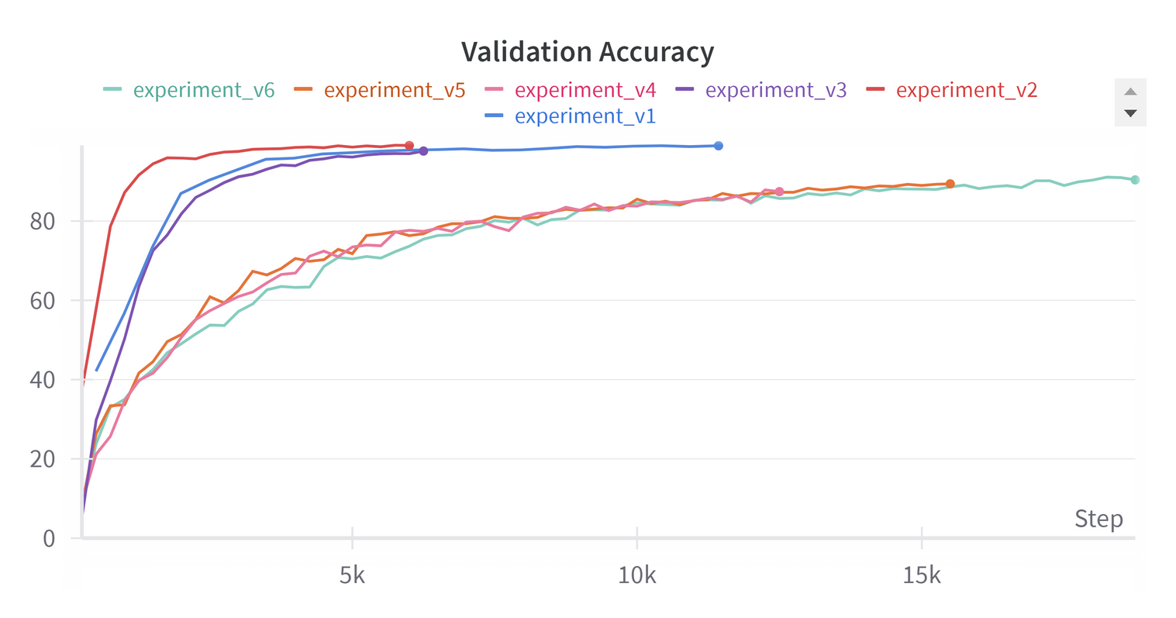
Implement 5 convolution layers
varying channels (64, 192, 384, 256) and kernel sizes of 3x3
combinations of convolution, batch normalization, ReLU activation, and dropout
Implement 3 Max Pooling layers with kernel_size of 2
CNN
Hypermeter Testing:
Epochs
Batch size
Parameters inside Early_Stopping
Data Augmentation & Balance
Validation Accuracy : 98.7%
Testing Accuracy: 93.6%
Notes:
-no grid search
Computational constraints limited our ability to perform a comprehensive grid search for the CNN

Slide 8

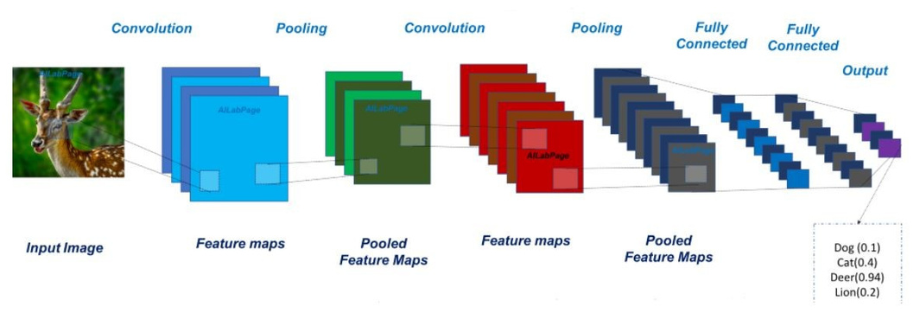
ResNet-18 Pretrained
ResNet-18 is a component of Microsoft's Residual Network Models.
Trained on more than 1.2 million images.
Adapt to different input sizes.
Data augmentations
Horizontal Flip
Rotations
The output layer is unfrozen, with specific parameters:
Batch Size: 350
Epochs: 35
Learning Rate: 0.001
Validation Accuracy : 99.66%
Testing Accuracy : 96%

Slide 9





INTERESTING FINDINGS
CHALLENGES
SVM Outperformed MLP Model
10x Faster Model Training
Data Augmentation insight
Despite trying data augmantation in all models we found that it hindered our performances
Training data already had data augmentation such as changes in brightness, and rotations
Neural Networks might not be the best solution for every problem
SVM was simpler/faster to train and it still performed well
Issues with SCC forced us to do a lot of the model training on Colab
Loading the data into the coding environment is significantly faster than reading it from Google Drive

Slide 10






Enhanced performance through Hyperparameter Tuning
Despite advantages of ResNet-18 trained on a lot of data.
Our custom model competed at a similar performance.
Leveraging Pre-trained Models
Accelerate model development and improvement
CONCLUSION
Applications
Assist driving application, providing drivers with information such as speed limits and road warnings
CNN Model 1
Test Accuracy: 93.6%
ResNet-18 Model
Test Accuracy: 96%

Slide 11
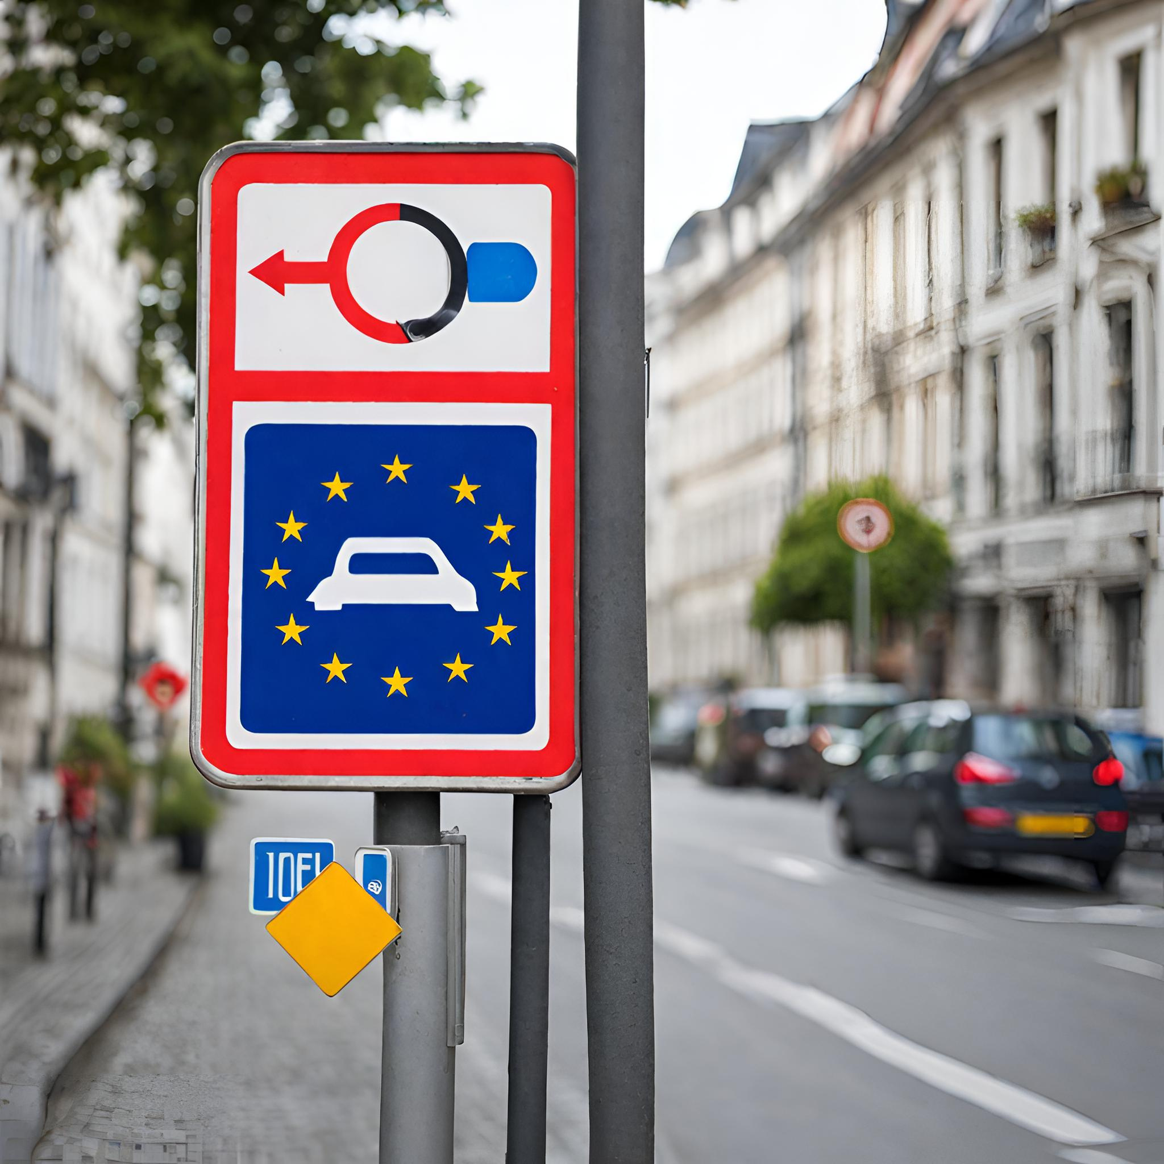
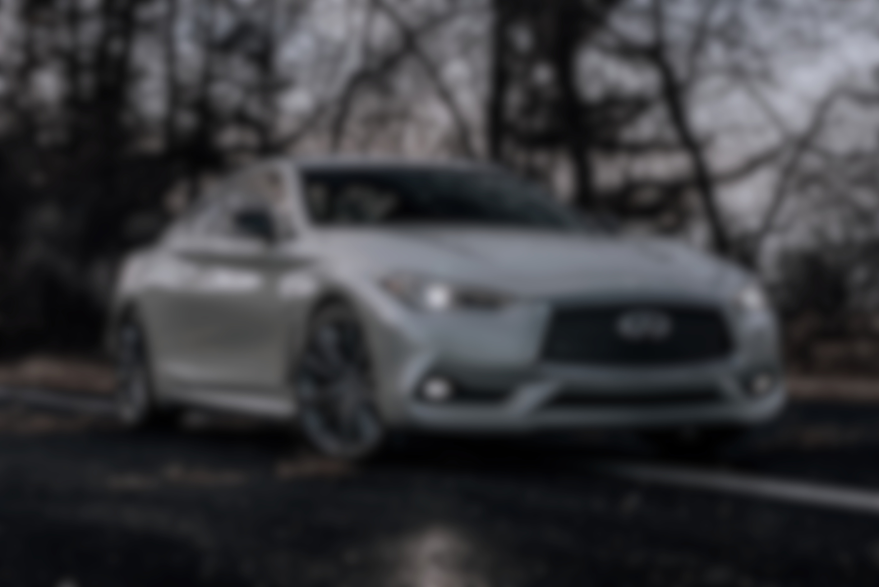
THANK
YOU !
Q & A

